Slide 1

Angular Part 5 – Services and Dependency Injection and Pipes Wednesday, January 3, 2024

Slide 2


Agenda
Services and Dependency Injection
Pipes

Slide 3
Services and Dependency Injection
Service is created using: ng generate service serviceName
Below diagram describes:
A single instance of LogService is injected into SaleService, and
A single instance of Sale Service is then injected into AppComponent, and
Another instances of LogService is injected into AppComponent
SaleService
LogService
Use
Use
Use
AppComponent

Slide 4
Services and Dependency Injection
The providedIn in the Injectable decorator of LogService and SaleService allow this instance to be available anywhere inside the application
The LogService instance is created and injected into SaleService by using the constructor in SaleService
SaleService
LogService
Use
import { Injectable } from '@angular/core'
// eslint-disable-next-line @typescript-eslint/consistent-type-imports
import { LogService } from './log.service'
@Injectable({
providedIn: 'root'
})
export class SaleService {
constructor (logService: LogService) {
console.log('Sale Service is constructed')
logService.outputNum()
}
}
import { Injectable } from '@angular/core'
@Injectable({
providedIn: 'root'
})
export class LogService {
private readonly num = 0
constructor () {
++this.num
console.log('LogService constructor is called')
}
outputNum (): void {
console.log(`num is ${this.num}`)
}
}

Slide 5

Services and Dependency Injection
The providers in the Component decorator indicates a new instance of LogService is injected
@Component({
selector: 'app-root',
standalone: true,
imports: [CommonModule, RouterOutlet],
templateUrl: './app.component.html',
styleUrl: './app.component.css',
providers: [LogService]
})
export class AppComponent {
title = 'AngularPart5'
constructor (private readonly logService: LogService, private readonly productService: ProductService, private readonly saleService: SaleService) {
console.log('AppComponent is constructed')
logService.outputNum()
}
}
SaleService
LogService
Use
Use
Use
AppComponent

Slide 6
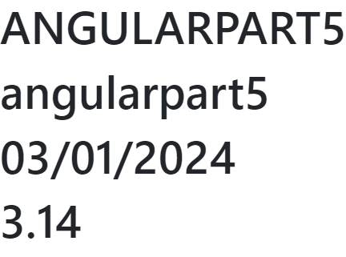
Pipes
Pipes are used to transform and display data
Angular provides us with many built-in pipe for common structures such as:
Uppercase pipe
Lowercase pipe
Date pipe
Decimal pipe
export class AppComponent {
title = 'AngularPart5'
date = new Date()
pi = 3.14
}
<h1>{{title | uppercase}}</h1>
<h1>{{title | lowercase}}</h1>
<h1>{{date | date: 'dd/MM/yyyy'}}</h1>
<h1>{{pi | number: '1.2-3'}}</h1>

Slide 7
Pipes Custom Pipes
Angular also provides us with the ability to create custom pipes: ng generate pipe pipeName
The generated code is:
import { Pipe, type PipeTransform } from '@angular/core'
@Pipe({
name: 'sum',
standalone: true
})
export class SumPipe implements PipeTransform {
transform (value: unknown, ...args: unknown[]): unknown {
return null
}
}

Slide 8

Pipes Custom Pipes
Example of sum pipe. Notice how the output number is round up
@Component({
selector: 'app-root',
standalone: true,
imports: [CommonModule, RouterOutlet, SumPipe],
templateUrl: './app.component.html',
styleUrl: './app.component.css',
providers: [LogService]
})
export class AppComponent {
title = 'AngularPart5'
date = new Date()
pi = 3.14
getNumberList (): number[] {
return [1.2567, 5.857345, 3.2856] // Sum=10.399645
}
}
<h1>{{getNumberList() | sum | number: '1.2-3'}}</h1>

Slide 9

Thank you
Sonny Hoang
sthoang62@gmail.com

